Slide 1
Area 10W 10U – 14U All-Stars Playoffs Coaches Meeting

Slide 2


Congratulations!

Slide 3
Tonight’s Agenda
Who Is Running The Playoff?
When And Where Are You Playing?
Who Is Playing?
How Is This Playoff Run?
Why Do This Playoff?

Slide 4
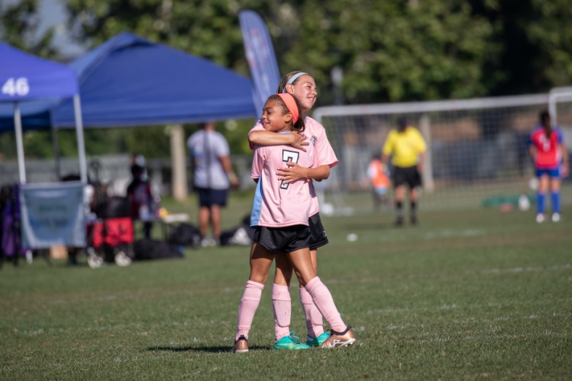
Who Is Running This Playoff?
Area Director (AD) – Dave Howells
Playoffs Director – Damian Cardona
Referee Admin – Cindy Elliott
Coach Admin – Eric Dettloff
Safety Director- Oscar Sepulveda
Statisticians – Cathy Gintjee, Monica Navarro

Slide 5
Area 10W Board of Directors (Regional Commissioners)
Region 39 - Megan Ruffinelli
Region 68 - Jeannette Rossling
Region 82 - Yolanda Beltran
Region 122 - John Maloney
Region 147 - Jason Crowley
Region 148 - Loring Navarro
Region 242 - Arnold Munoz
Region 304 - Scott Barradas
Region 683 - Dan Runhaar

Slide 6



When And Where Are You Playing?
One Weekend (Jan 10-11) In Camarillo
Rain Date- January 24-25, 2026
Pleasant Valley Sports Complex
Check Website For Playoff Status
AYSO10W.org

Slide 7
Teams violating this rule may be subject to a 2-point deduction in standings.

Slide 8
Who Is Playing In This Playoff?
59 All-Star Teams From Area 10W
Nine Regions Participating
Region | Name |  | Region | Name
39 | Ventura |  | 148 | South Oxnard
68 | Camarillo |  | 242 | Fillmore
82 | Santa Paula |  | 304 | North Oxnard
122 | Santa Barbara |  | 683 | Carpinteria
147 | Ojai

Slide 9
Who Is Playing In This Playoff?
 |  | B10U | G10U | B12U | G12U | B14U | G14U
Participating Teams |  | 12 | 11 | 11 | 9 | 8 | 8
Number of Pools |  | 3 | 3 | 3 | 3 | 2 | 2
Teams per pool |  | 4 | 4/4/3 | 4/4/3 | 3 | 4 | 4
Teams Advancing to Semi Finals/ Finals |  | 4 | 4 | 4 | 4 | 4 | 4
Saturday | JAN 10 | Pool Play
Sunday | JAN 11 | Pool, Semi-Final, and Finals/Consolation
Opponents Are Selected By Blind Draw

Slide 10
How Is This Playoff Run?
Pool Points Awarded Per Game
Win | 6 Points
Tie | 3 Points
Shutout | 1 Point
Goal | 1 Point For Each Goal (Max Of 3)
Sendoff | -1 Point For Each Player Or Coach Sendoff
Tiebreakers For Pool Play Standing Winner Of Head-to-head Play Fewest Goals Allowed Most Wins Least Amount Of Sendoffs/ Cautions Most Shutouts Most Goals Scored (Max Of 5 Per Game) Kicks From The Mark (If Time Allows) Coin Toss

Slide 11
How Is This Playoff Run?
All Teams Follow Equal Play Rule For The Playing Time Of All Participating Players
Oversize rosters - 50% of game
!! Please Sign Game Card After Game !!
Division | Pool Play | Single Elimination
10U | 40 Min | 40 Min Plus, If Tied, PKs
12U | 46 Min | 46 Min Plus, If Tied, PKs
14U | 50 Min | 50 Min Plus, If Tied, PKs

Slide 12
How Is This Playoff Run?
Player Roster Signed By RC Must Be Submitted To Area At Coach Meeting
No Changes To Player Roster after check-in
Coaches Must Wear ID Badges
Game Schedules Are In the Team Packet

Slide 13
How Is This Playoff Run?
Team Check-in ONE HOUR Prior To 1st Game Each Day
All Players Must Wear Their Official Uniform Provided By The Region Including The Proper Soccer Shorts.
Present Player Release Forms And Turn In All Game Cards At Saturday Check-in
Game Cards-Please Fill Out Correctly And Legibly Please List Players By Numerical Order (Excel and PDF formats available online)
Get One Card Before 1st Game And Pick Up Remaining Cards After 1st Game

Slide 14
How Is This Playoff Run?
No Player Release Forms
No Play
No Exceptions

Slide 15

Area Referee Administrator
Cindy Elliott

Slide 16
How Is This Playoff Run?
Each Region Provides Referee Support For This Playoff
Please Respect All Calls Made By These Volunteer Referees
Coaches Must Control Touchline
Area 10W Has Zero Tolerance For Harassment Of Referees
Ask The Referee Tent for Assistance If You Have Concerns Regarding The Officiating

Slide 17

Area Safety Director
Oscar Sepulveda

Slide 18
How Is This Playoff Run?
EMT’s Are On Site For All Serious Injuries
Use Field Monitors To Get Help
Coaches Must File An Incident Report Before Their Next Game When A Player Is Substituted For Injury
Should A Player Require Professional Medical Treatment (i.e. EMS), The Parents Must Provide An AYSO Parent Release Form To Allow The Player To Return To The Playoff

Slide 19
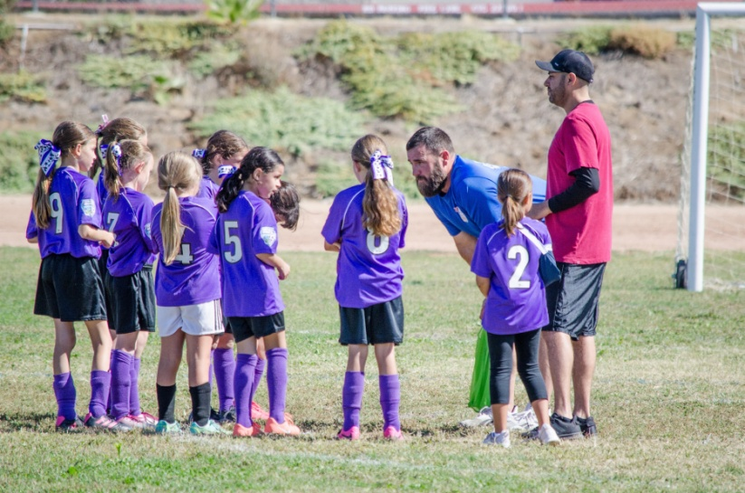

Area Coach Administrator
Eric Dettloff

Slide 20
Why Is Area W Running This Playoff?
Cultural Exchange Between Regions
Ambassadors For Your Region
Sportsmanship Matters More Than Winning
Avoid Blowouts (No >5 Goal Differentials)
Positive Coaching And Touchlines
No Dissent – Respect All Calls
Touchline Behavior

Slide 21
Why Is Area W Running This Playoff?
Two Teams In Each Division MAY Be Invited To Participate In Section 10 All-Star Championship Playoff
Feb 21-22 2026
Kern County Soccer Park – Bakersfield Ca
Teams Are Invited By Area Director Based On Sportsmanship, Sideline Behavior and Playoff Win-loss Record,

Slide 22
Coaches- Registered, trained and certified!
All-Stars Requires A Coach And Asst Coach
Volunteer Registration Expires?
Safe Sport Expires?
Live Scan Complete?
Age Specific Coach Trained? 10U, 12U, Intermediate Coach
Be Pro Active And Check with your Region CVPA
Verified!!!
Section 10 Rules and Regs

Slide 23
Coach Code of Conduct Form
Form Required for Area 10 W and Section 10 Playoffs

Slide 24
Referee Abuse Prevention Touchline Etiquette Coaches and Parents
Area Director

Slide 25
FIELDS: Thank You Region 68
Please limit your team warm up to keep games on time and use the areas designated on the field map.
Please be aware of any wet spots and feel free to mark them (cones, etc.). This will assist us in directing field maintenance personnel to address any problem areas.
At half time please be mindful of time.
Move away from the fields after your game to allow the next team to get settled.

Slide 26
Pleasant Valley Fields

Slide 27

Area10W will do everything possible to complete All Star Playoffs by the dates listed
Area10W will notify the Regional Commissioners of any change as well as publish the changes on our website AYSO10W.org

Slide 28
Good Luck In The Playoff!!! Any Questions?

